Slide 1




HMH - DataPattern Leadership SyncUp
- May 08, 2026
1

Slide 2

Monthly Status Report – HMH
Highlights & Accomplishments
Completed Platforms & Tasks
Ongoing Work (In Progress)
Report Generation & Data Structuring Building export-ready reports Ensuring correct relational mapping (Findings ↔ Assets ↔ Test Cycles) JIRA Project Migration Migrating project from legacy environment to HMH setup Validating data integrity post-migration Report Validation Automation Agent-based validation still under development Aligning logic with updated SOP controls
Platforms: ED_M180 – VA HMH Labs: 1. Writable - VA 2. AI Tools - VA 3. Flight - VA | JIRA Dashboard Enhancement - Completed Governance view and reporting structure finalized for improved visibility SOP Updates - Incorporated Feedback integrated and aligned with current workflows Vulnerability Assessment – Completed ED-M180 & HMH labs Vulnerability Assessment has been successfully completed, and the report has been submitted
Upcoming Activities ( Next Plan)
Complete JIRA Migration & Validation Finalize Report Export Framework (client-ready format) Deploy Automation Agents for Report Validation Perform Data Accuracy Testing (Sampling + Cross-validation)
Risk & Issues
JIRA Migration Dependency Migration delays may impact reporting continuity Automation Not Yet Production Ready Validation agents still under development → risk to reporting accuracy Mitigation Phased migration with validation to ensure continuity and accuracy.

Slide 3
Quality‑Driven Skill Advancement & Process Evolution
Enhanced Testing Methodology
Capability & Skill Uplift
Quality Driven Culture
Built application‑aligned testing frameworks that ensure deeper, more predictable coverage across varied architectures
Strengthened advanced manual testing techniques to uncover multi‑step, logic‑driven vulnerabilities
Introduced a structured false‑positive elimination workflow, improving accuracy and reducing noise
Added scenario‑based test design, enabling testers to validate complex business flows more effectively
Implemented evidence‑quality standards, ensuring every finding is supported with clear, reproducible proof
Conducted real‑world adversarial simulation labs to sharpen offensive and defensive thinking
Improved severity calibration discipline, aligning technical issues with actual business impact
Established a peer‑review + secondary validation layer to ensure consistency and technical precision
Launched micro‑learning modules on APIs, cloud security, identity attacks, and platform‑specific risks
Introduced cross‑platform rotations, enabling testers to build broader product expertise
Adopted standardized checklists to eliminate tester‑to‑tester variability
Strengthened collaborative review cycles, reducing rework and improving analytical depth
Implemented root‑cause analysis practices to help testers understand systemic issues behind vulnerabilities
Added weekly technical huddles to share patterns, lessons learned, and emerging threat insights
Embedded continuous improvement loops, feeding assessment learnings back into SOPs and frameworks

Slide 4
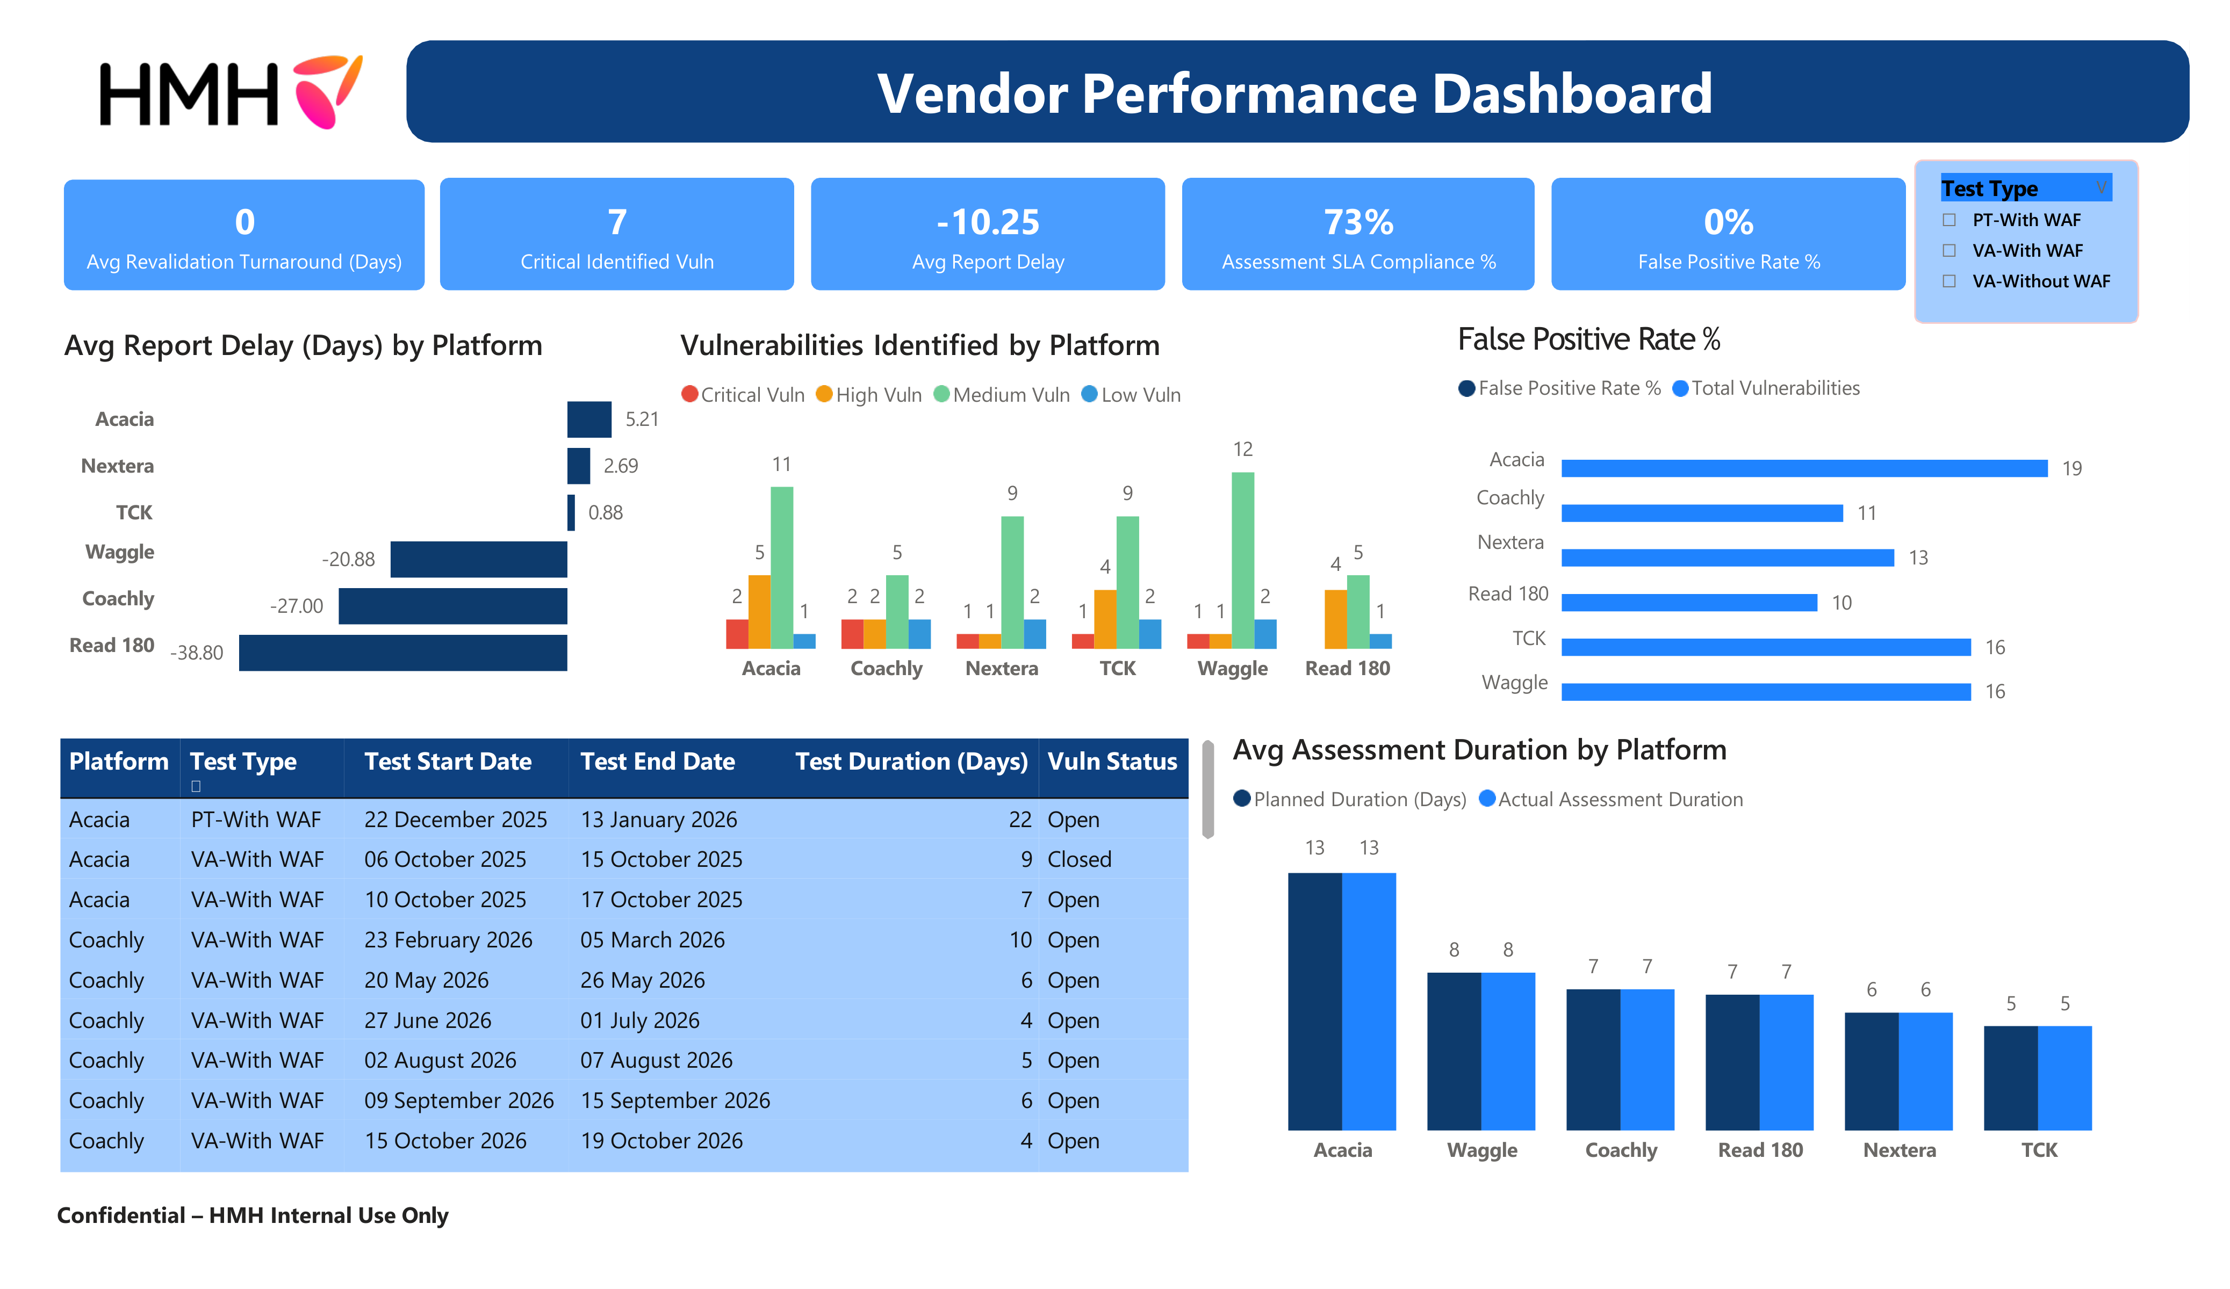
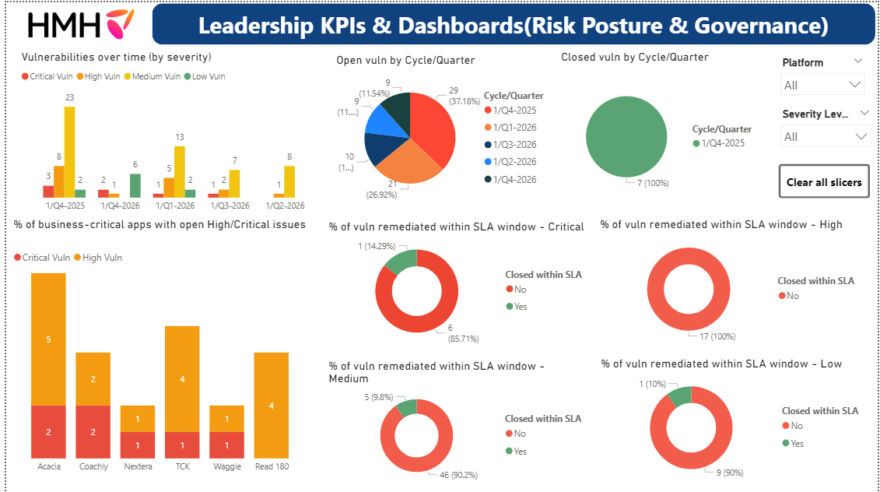
VAPT Governance & KPI Dashboard
Centralized Power BI dashboard for real-time monitoring of VAPT performance and risk posture
Consolidates key security and operational KPIs into a unified view
Tracks SLA compliance, reporting efficiency, and remediation progress
Provides platform-level insights into:
  Assessment duration trends
  Vulnerability distribution by severity
  Report delay patterns
Enables end-to-end visibility of the assessment lifecycle
(Start Date → End Date → Duration → Test Type)
Supports data-driven decision making, remediation prioritization, and governance oversight

Slide 5

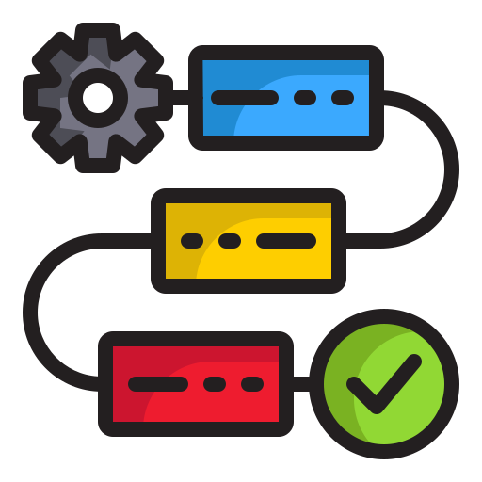

Operational Efficiency Through Simplification
Unified Tracking
A single, consolidated system that brings all testing, findings, and remediation workflows into one governed platform.
Single Jira Ecosystem
Centralized Workflows
Unified Data View
Eliminated Redundancy
Audit‑Ready History
Ownership
Clear responsibility and governance for every task and vulnerability, ensuring traceability and controlled closure.
Clear Task Owners
Reviewer Assignments
Approval Gates
Linked Remediation
Traceable Actions
Standardized workflow
A consistent, repeatable VAPT lifecycle with structured controls, ensuring uniform execution across all engagements.
Defined Lifecycle
Custom Issue Types
Role‑Based Ownership
Structured Transitions
Mandatory Checkpoints
Real time visibility
Live insights and automated monitoring that provide stakeholders with immediate awareness of progress and risks.
Live Dashboards
SLA Monitoring
Automated Alerts
Escalation Triggers
Stakeholder Insights

Slide 6



Unified & Scalable Delivery Framework
End‑to‑End
Standardization
Developed comprehensive SOPs covering Scoping → Testing → Reporting → Retesting
Ensured every engagement follows a repeatable, predictable process, regardless of team size or platform
Reduced onboarding time with role‑specific playbooks and quick‑start guides
Standardized terminology, workflows, and expectations across all testers
Enabled consistent execution even during high‑volume assessment cycles
Uniform Reporting & Quality Controls
Standardized templates with embedded validation rules for structure, severity, and evidence formatting
Reduced review cycles by ensuring reports are client‑ready from the first draft
Improved readability through structured narratives and aligned severity logic
Added pre‑delivery governance checks to ensure alignment with client expectations
Strengthened evidence requirements to ensure clear, defensible, audit‑ready findings
Scalable, High‑Quality Delivery Engine
Introduced regular technical + governance review cadences to maintain delivery momentum
Enabled parallel assessments without compromising depth or accuracy
Implemented capacity planning mechanisms to forecast workload and allocate resources efficiently
Strengthened QA with multi‑layer validation, ensuring completeness and reproducibility
Built a model that supports increasing assessment volume while maintaining consistent quality

Slide 7


Thank You
Time To Transform Is …
…
NOW
6
6
6

Slide 8

AI-Driven Report Quality Assurance
Advanced Detection Engine
Human-in-the-Loop Synergies
Severity Calibration
Pre-Delivery Validation
Detects inconsistencies between technical findings and assigned risk levels to ensure grading accuracy.
Implemented as a mandatory gatekeeper agent prior to final client delivery to mitigate human oversight.
Evidentiary Integrity
Intelligent Validation Insights
Identifies instances of missing or weak evidence, ensuring all claims are supported by technical artifacts.
Provides reviewers with context-aware suggestions, significantly reducing manual QA cycles.
Operational Efficiency
Redundancy Analysis
Optimizes the internal review workflow by focusing human expertise on complex analytical tasks.
Automated detection of duplicate findings to streamline report narratives and improve client readability.

